Slide 1
How to get Your Test Scores
Step-by-Step instructions for creating a Collegeboard account and getting your test scores

Slide 2
Go to www.collegeboard.org You must have an account to get your test scores!

Slide 3
You will create a student account

Slide 4
Fill in the information *red asterisk indicates required questions
Email address can be your school or personal email
Zip code is for where you live, not the school
Be sure to put where you go to school
Username is 6-15 characters with letters and numbers
Password is 7-15 characters with letters and numbers
Subscriptions: uncheck the box if you do not want to receive monthly newsletters
Parent information can be left blank

Slide 5
Confirm the information
When your account is created, wait 10 seconds and it will take you to your main profile page.

Slide 6
Select SAT or PSAT to access your scores
PSAT scores should show after clicking on the link. If you need an access code, please see Miss Gelder.

Slide 7
Click on the SAT drop down menu and select "Scores"

Slide 8
Click on "Get Your SAT Scores"

Slide 9
If your scores do not automatically show up, click "add scores"
Re-enter your password to verify your identity
Scroll down to the address section and fill in your home address
Scroll to the bottom and click "update"
You should now have your score report! Keep going in this presentation to learn how to read your score report.
*If it asks you for a registration number, see Miss Gelder

Slide 10
How to read your scores
First you see your 3 main scores: Total score, Evidence-Based Reading and Writing, and Math.
Score ranges vary by test -
SAT: 400-1600 total, 200-800 for each section
PSAT 10: 320-1520 total, 160-760 for each section
PSAT 8/9: 240-1440 total, 120-720 for each section
Click "View Details" for more specific score information
SAT: Want to know how this score compares to the ACT? You can find a score converter here. Convert to the old SAT, then click "Show ACT Scores Comparison

Slide 11
Report Details
Benchmarks: Collegeboard has designated benchmark scores that indicate a level of college readiness. You can see if your section scores meet or exceed benchmark levels.
Percentiles: Percentiles show you how your scores compare to other students who took the test.
You have 2 percentiles: National Representative and User
- National Representative shows your score compared to ALL students in the country who took the test
- User percentile shows your score compared to students in the country who take the test by choice, not because they have to take it
Example: a 50th percentile score means you scored the same or better than 50% of test takers in that percentile group.

Slide 12
Test Questions (PSAT 8/9 and 10 only)
This section allows you to see answers for each sections of the test. Information in this section includes:
# of questions answered correctly or incorrectly
Exact questions you got right or wrong
Difficultly level or each question
Type of skill that the question is measuring
PSAT 10 – you get to have your test booklet back. This makes a great study tool for the PSAT/NMSQT and the SAT!

Slide 13
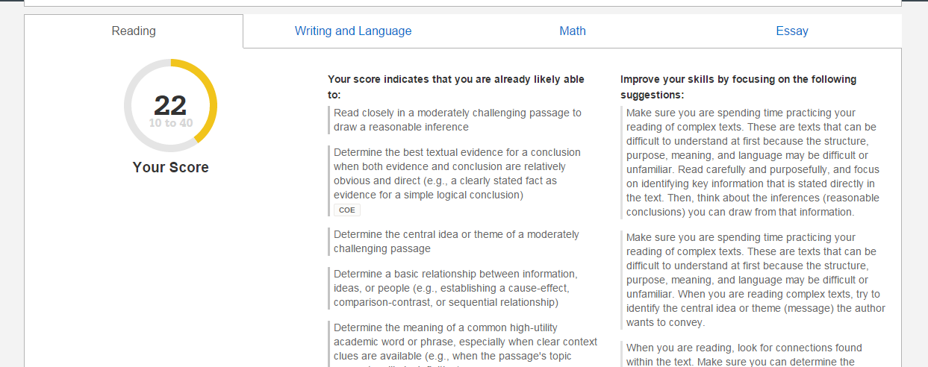
Skills Insight
This section allows you to see scores for each individual section of the test (Reading, Writing & Language, Math, and Essay for the SAT)
Along with scores, you also see what skills you are likely able to already do and what to focus on in order to improve your skills.

